Slide 1
Chapter 3
Agile Development
Software Engineering: A Practitioner’s Approach, 7/e
by Roger S. Pressman
use.

Slide 2
The Manifesto for
Agile Software Development
“We are uncovering better ways of developing software by doing it and helping others do it. Through this work we have come to value:
  Individuals and interactions over processes and tools
  Working software over comprehensive documentation
  Customer collaboration over contract negotiation
  Responding to change over following a plan
That is, while there is value in the items on the right, we value the items on the left more.”
Notes:
a public declaration of intentions, opinions, objectives, or motives, as one issued by a government, sovereign, or organization.

Slide 3
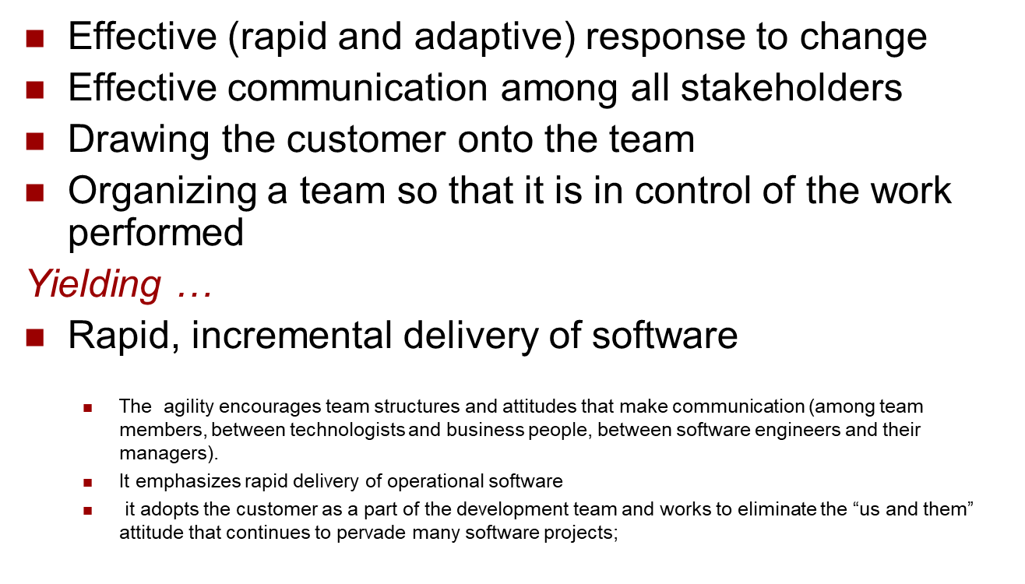
What is “Agility”?

Slide 4

Agility and the Cost of Change
These slides are designed to accompany Software Engineering: A Practitioner’s Approach, 7/e (McGraw-Hill, 2009) Slides copyright 2009 by Roger Pressman.

Slide 5
`
In software development the cost of change increases nonlinearly as a project progresses (Figure 3.1, solid black curve).
It is relatively easy to accommodate a change when a software team is gathering requirements (early in a project). A usage scenario might have to be modified, a list of functions may be extended, or a written specification can be edited. The costs of doing this work are minimal, and the time required will not adversely affect the outcome of the project.
But what if we fast-forward a number of months? The team is in the middle of validation testing, and an important stakeholder is requesting a major functional change. The change requires a modification, Costs go up quickly, and the time and cost required to ensure that the change is made without unintended side effects is nontrivial.

Slide 6
Proponents of agility argue that a well-designed agile process “flattens” the cost of change curve (Figure 3.1, shaded, solid curve), allowing a software team to accommodate changes late in a software project without dramatic cost and time impact.
The agile process encompasses incremental delivery. When incremental delivery is coupled with other agile practices such as continuous unit testing and pair programming (discussed later in this chapter), the cost of making a change is attenuated.
Although debate about the degree to which the cost curve flattens is ongoing, there is evidence to suggest that a significant reduction in the cost of change can be achieved.
These slides are designed to accompany Software Engineering: A Practitioner’s Approach, 7/e (McGraw-Hill, 2009) Slides copyright 2009 by Roger Pressman.

Slide 7
An Agile Process
Is driven by customer descriptions of what is required (scenarios). Some assumptions:
  Recognizes that plans are short-lived (some requirements will persist, some will change. Customer priorities will change)
  Develops software iteratively with a heavy emphasis on construction activities (design and construction are interleaved, hard to say how much design is necessary before construction. Design models are proven as they are created. )
  Analysis, design, construction and testing are not predictable.
An incremental development strategy should be instituted. Software increments must be delivered in short time periods so that adaptation keeps pace with change (unpredictability).
This iterative approach enables the customer to evaluate the software increment regularly, provide necessary feedback to the software team , and influence the process adaptations that are made to accommodate the feedback.

Slide 8
Agile Technology
the requirements are decomposed into many small parts that can be incrementally developed.
The agile model adopts an iterative approach. Each incremental part is developed over an iteration.
Each iteration is intended to be small and easily manageable and lasting for a couple of weeks only. At a time, only one increment is planned, developed, and then deployed at the customer site.
No long-term plans are made. The time to complete an iteration is called a time box. The implication of the term time box is that the end date for an iteration does not change. That is, the delivery date is considered sacrosanct.
The development team can, however, decide to reduce the delivered functionality during a time box if necessary.
A central principle of the agile model is the delivery of an increment to the customer after each time box.

Slide 9
Agility Principles - I
1. Our highest priority is to satisfy the customer through early and continuous delivery of valuable software.
2. Welcome changing requirements, even late in development. Agile processes harness change for the customer's competitive advantage.
3. Deliver working software frequently, from a couple of weeks to a couple of months, with a preference to the shorter timescale.
4. Business people and developers must work together daily throughout the project (no hierarchy).
5. Build projects around motivated individuals. Give them the environment and support they need, and trust them to get the job done.
6. The most efficient and effective method of conveying information to and within a development team is face–to–face conversation.

Slide 10
Agility Principles - II
7. Working software is the primary measure of progress.
8. Agile processes promote sustainable development. The sponsors, developers, and users should be able to maintain a constant pace indefinitely.
9. Continuous attention to technical excellence and good design enhances agility.
10. Simplicity – the art of maximizing the amount of work not done – is essential.
11. The best architectures, requirements, and designs emerge from self–organizing teams.
12. At regular intervals, the team reflects on how to become more effective, then tunes and adjusts its behavior accordingly.

Slide 11
Human Factors
the process molds to the needs of the people and team, not the other way around
key traits must exist among the people on an agile team and the team itself:
  Competence. ( talent, skills, knowledge)
  Common focus. ( deliver a working software increment )
  Collaboration. ( peers and stakeholders)
  Decision-making ability. ( freedom to control its own destiny)
  Fuzzy problem-solving ability.(ambiguity and constant changes, today problem may not be tomorrow’s problem)
  Mutual trust and respect.
  Self-organization. ( themselves for the work done, process for its local environment, the work schedule)

Slide 12
Scrum
A software development method Originally proposed by Schwaber and Beedle in early 1990.
Scrum—distinguishing features
  Development work is partitioned into “packets”
  Testing and documentation are on-going as the product is constructed
  Work units occurs in “sprints” and is derived from a “backlog” of existing changing prioritized requirements
  Changes are not introduced in sprints (short term but stable) but in backlog.
  Meetings are very short (15 minutes daily) and sometimes conducted without chairs ( what did you do since last meeting? What obstacles are you encountering? What do you plan to accomplish by next meeting?)
  “demos” are delivered to the customer with the time-box allocated. May not contain all functionalities. So customers can evaluate and give feedbacks.

Slide 13
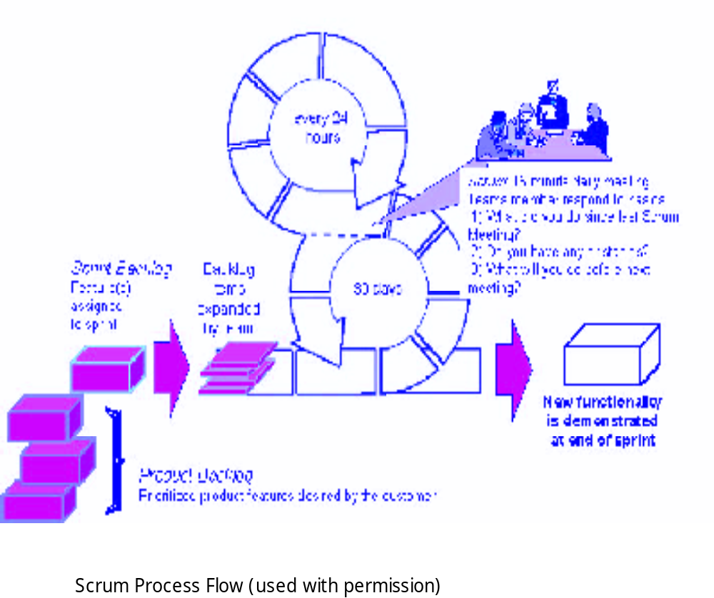
Scrum
These slides are designed to accompany Software Engineering: A Practitioner’s Approach, 7/e (McGraw-Hill, 2009) Slides copyright 2009 by Roger Pressman.

Slide 14
Extreme Programming (XP)
In order to illustrate an agile process in a bit more detail, an overview of Extreme Programming (XP) is given, the most widely used approach to agile software development. Although early work on the ideas and methods associated with XP occurred during the late 1980s, the seminal work on the subject has been written by Kent Beck
1. XP Values
Beck defines a set of five values that establish a foundation for all work performed
as part of XP—communication, simplicity , feedback, courage, and respect.
Each of these values is used as a driver for specific XP activities, actions, and tasks.

Slide 15
communication between software engineers and other stakeholders communicating important concepts, continuous feedback, and the avoidance of voluminous documentation as a communication medium.
To achieve simplicity, XP restricts developers to design only for immediate needs, rather than consider future needs
Feedback is derived from three sources: the implemented software itself, the customer, and other software team members.
An agile XP team must have the discipline (courage) to design for today, recognizing that future requirements may change dramatically, thereby demanding substantial rework of the design and implemented code.
the agile team inculcates respect among it members, between other stakeholders and team members, and indirectly, for the software itself.

Slide 16
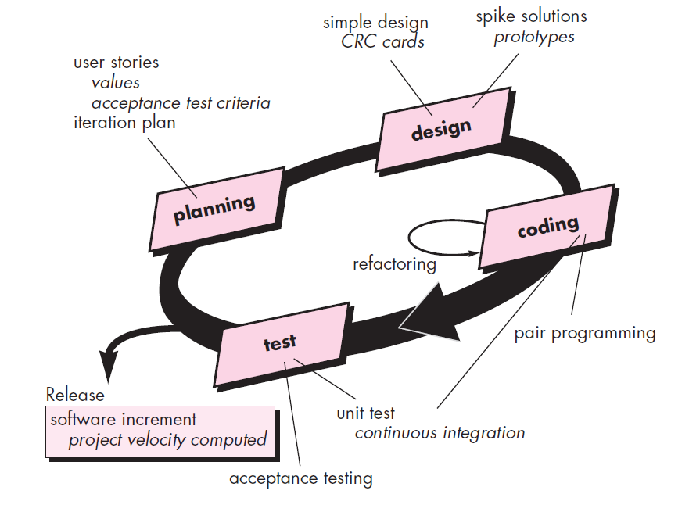

These slides are designed to accompany Software Engineering: A Practitioner’s Approach, 7/e (McGraw-Hill, 2009) Slides copyright 2009 by Roger Pressman.

Slide 17
In order to achieve effective communication between software engineers and other stakeholders (e.g., to establish required features and functions for the software),XP emphasizes close, yet informal (verbal) collaboration between customers and developers, the establishment of effective metaphors for communicating important concepts, continuous feedback, and the avoidance of voluminous documentation as a communication medium.(a metaphor is “a story that everyone—customers, programmers, and managers can tell about how the system works)
To achieve simplicity, XP restricts developers to design only for immediate needs, rather than consider future needs.
Feedback is derived from three sources: the implemented software itself, the customer, and other software team members. By designing and implementing an effective testing strategy, the software (via test results) provides the agile team with feedback. XP makes use of the unit test as its primary test
the agile team inculcates respect among it members, between other stakeholders and team members, and indirectly, for the software itself.

Slide 18
Extreme Programming (XP)
The XP Process
The most widely used agile process, originally proposed by Kent Beck in 2004. It uses an object-oriented approach.
  XP Planning
  Begins with the listening, leads to creation of “user stories” that describes required output, features, and functionality. Customer assigns a value(i.e., a priority) to each story.
  Agile team assesses each story and assigns a cost (development weeks. If more than 3 weeks, customer asked to split into smaller stories)
  Working together, stories are grouped for a deliverable increment next release.
  A commitment (stories to be included, delivery date and other project matters) is made. Three ways: 1. Either all stories will be implemented in a few weeks, 2. high priority stories first, or 3. the riskiest stories will be implemented first.
  After the first increment “project velocity”, namely number of stories implemented during the first release is used to help define subsequent delivery dates for other increments. Customers can add stories, delete existing stories, change values of an existing story, split stories as development work proceeds.

Slide 19
Extreme Programming (XP)
XP Design ( occurs both before and after coding as refactoring is encouraged)
  Follows the KIS principle (keep it simple) Nothing more nothing less than the story.
  Encourage the use of CRC (class-responsibility-collaborator) cards in an object-oriented context. The only design work product of XP. They identify and organize the classes that are relevant to the current software increment. (see Chapter 8)
For difficult design problems, XP recommends the immediate creation of an operational prototype of that portion of the design called “spike solutions”—a design prototype for that portion is implemented and evaluated.
  Encourages “refactoring”—an iterative refinement of the internal program design. Does not alter the external behavior yet improve the internal structure. Minimize chances of bugs. More efficient, easy to read.

Slide 20
XP Coding
The team develops a series of unit tests. Once the unit test has been created, the developer is better able to focus on what must be implemented to pass the test. Once the code is complete, it can be unit-tested immediately, thereby providing instantaneous feedback to the developers.
A key concept during the coding activity is pair programming. XP recommends that two people work together. This provides a mechanism for realtime problem solving and real-time quality assurance. In practice, each person takes on a slightly different role. For Example, one person might think about the coding details of a particular portion of The design while the other ensures that coding standards are Being followed or that the code for the story will satisfy the unit test.
As pair programmers complete their work, the code they develop is integrated with the work of others. In some cases this is performed on a daily basis by an integration team. In other cases, the pair programmers have integration responsibility

Slide 21
XP Testing
  All unit tests are executed daily and ideally should be automated. Regression tests are conducted to test current and previous components.
  “Acceptance tests” are defined by the customer and executed to assess customer visible functionality
Notes:
Regression testing. Each time a new module is added as part of integration testing,the software changes. New data flow paths are established, new I/O may occur, and new control logic is invoked. These changes may cause problems with functions that previously worked flawlessly. In the context of an integration test strategy, regression testing is the reexecution of some subset of tests that have already been
conducted to ensure that changes have not propagated unintended side effects.

Slide 22

Extreme Programming (XP)
These slides are designed to accompany Software Engineering: A Practitioner’s Approach, 7/e (McGraw-Hill, 2009) Slides copyright 2009 by Roger Pressman.

Slide 23
The XP Debate
Requirements volatility: customer is an active member of XP team, changes to requirements are requested informally and frequently. As a consequences the scope of the project can change and earlier work may have to be modified to accommodate current needs.
Conflicting customer needs: different customers' needs need to be assimilated. Different vision or beyond their authority.
Requirements are expressed informally: Use stories and acceptance tests are the only explicit manifestation of requirements. Formal models may avoid inconsistencies and errors before the system is built. Changing nature makes such models obsolete as soon as they are developed.
Lack of formal design: XP deemphasizes the need for architectural design. Complex systems need overall structure to exhibit quality and maintainability. The incremental nature limits complexity as simplicity is a core value.

Slide 24
Other Agile Process Models
The most widely used of all agile process models is Extreme Programming (XP). But many other agile process models have been proposed and are in use across the industry. Among the most common are.
  Adaptive Software Development (ASD)
  Scrum
  Dynamic Systems Development Method (DSDM)
  Crystal
  Feature Drive Development (FDD)
  Lean Software Development (LSD)
  Agile Modeling (AM)
  Agile Unified Process (AUP)

Slide 25
Adaptive Software Development (ASD)
Originally proposed by Jim Highsmith (2000)focusing on human collaboration and team self-organization as a technique to build complex software and system.
ASD — distinguishing features
  Mission-driven planning
  Component-based focus
  Uses “time-boxing” (See Chapter 24)
  Explicit consideration of risks
  Emphasizes collaboration for requirements gathering
  Emphasizes “learning” throughout the process
Notes:
timeboxing allocates a fixed time period, called a time box, to each planned activity. Several project management approaches use timeboxing. It is also used for individual use to address personal tasks in a smaller time frame. It often involves having deliverables and deadlines, which will improve the productivity of the user.

Slide 26
Three Phases of ASD
1. Speculation:
  project is initiated and adaptive cycle planning is conducted.
  Adaptive cycle planning uses project initiation information- the customer’s mission statement, project constraints (e.g. delivery date), and basic requirements to define the set of release cycles (increments) that will be required for the project.
  Based on the information obtained at the completion of the first cycle, the plan is reviewed and adjusted so that planned work better fits the reality.
These slides are designed to accompany Software Engineering: A Practitioner’s Approach, 7/e (McGraw-Hill, 2009) Slides copyright 2009 by Roger Pressman.

Slide 27
Three Phases of ASD
2. Collaborations are used to multiply their talent and creative output beyond absolute number . It encompasses communication and teamwork, but it also emphasizes individualism, because individual creativity plays an important role in collaborative thinking.
It is a matter of trust.
  criticize without animosity,
  assist without resentments,
  work as hard as or harder than they do.
  have the skill set to contribute to the work at hand
  communicate problems or concerns in a way that leas to effective action.

Slide 28
3. Learning:
As members of ASD team begin to develop the components, the emphasis is on “learning”.
Highsmith argues that software developers often overestimate their own understanding of the technology, the process, and the project and that learning will help them to improve their level of real understanding. Three ways:
  focus groups,
  technical reviews
  project postmortems.
Notes:
A project post-mortem is a process, usually performed at the conclusion of a project, to determine and analyze elements of the project that were successful or unsuccessful. Project post-mortems are intended to inform process improvements which mitigate future risks and to promote iterative best practice.

Slide 29
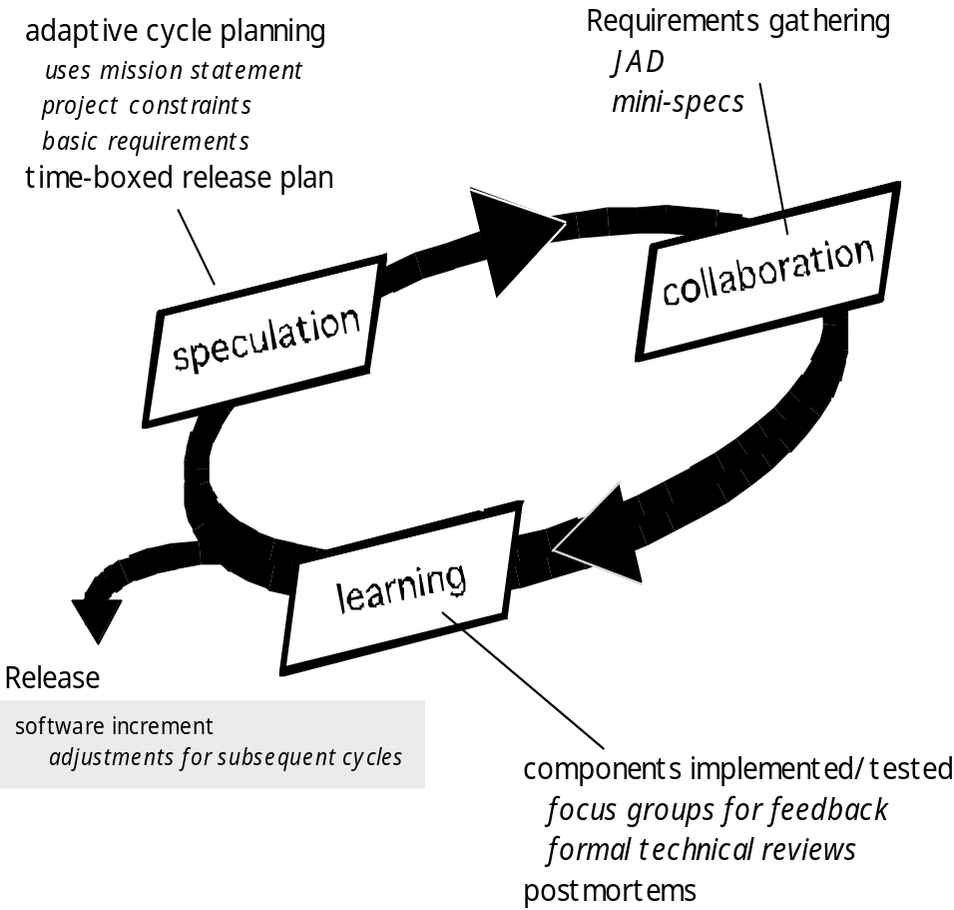
Adaptive Software Development
Notes:
Joint Application Development) is a methodology that involves the client or end ... as using fewer formal methodologies and reusing software components

Slide 30
Dynamic Systems Development Method
It is an agile software development approach that provides a framework for building and maintaining systems which meet tight time constraints through the use of incremental prototyping in a controlled project environment.
Promoted by the DSDM Consortium (www.dsdm.org)
DSDM—distinguishing features
  Similar in most respects to XP and/or ASD
  Nine guiding principles
    Active user involvement is imperative.
    DSDM teams must be empowered to make decisions.
    The focus is on frequent delivery of products.
    Fitness for business purpose is the essential criterion for acceptance of deliverables.
    Iterative and incremental development is necessary to converge on an accurate business solution.
    All changes during development are reversible.
    Requirements are baselined at a high level
    Testing is integrated throughout the life-cycle.
These slides are designed to accompany Software Engineering: A Practitioner’s Approach, 7/e (McGraw-Hill, 2009) Slides copyright 2009 by Roger Pressman.

Slide 31
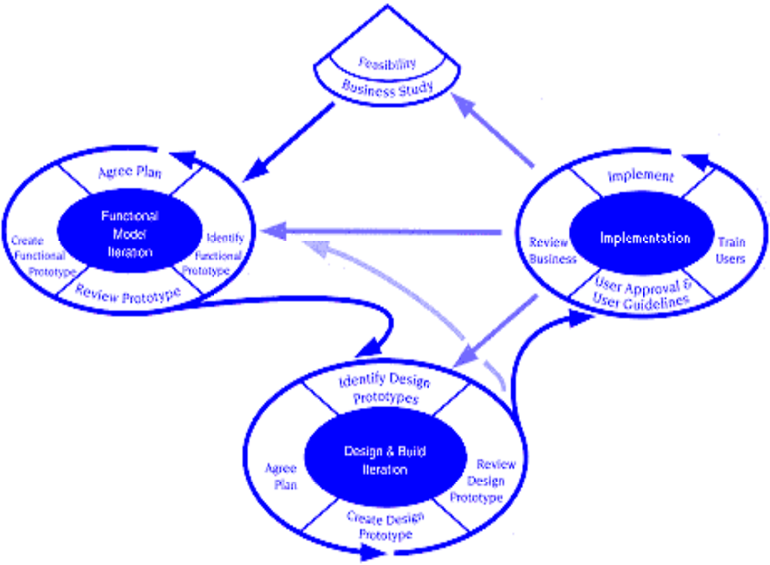
Dynamic Systems Development Method
DSDM Life Cycle (with permission of the DSDM consortium)
These slides are designed to accompany Software Engineering: A Practitioner’s Approach, 7/e (McGraw-Hill, 2009) Slides copyright 2009 by Roger Pressman.

Slide 32
Crystal
Proposed by Cockburn and Highsmith
Crystal—distinguishing features
  Actually a family of process models that allow “maneuverability” based on problem characteristics
  Face-to-face communication is emphasized
  Suggests the use of “reflection workshops” to review the work habits of the team
These slides are designed to accompany Software Engineering: A Practitioner’s Approach, 7/e (McGraw-Hill, 2009) Slides copyright 2009 by Roger Pressman.

Slide 33
Feature Driven Development
Originally proposed by Peter Coad et al as a object-oriented software engineering process model.
FDD—distinguishing features
  Emphasis is on defining “features” which can be organized hierarchically.
    a feature “is a client-valued function that can be implemented in two weeks or less.”
  Uses a feature template
    <action> the <result> <by | for | of | to> a(n) <object>
    E.g. Add the product to shopping cart.
    Display the technical-specifications of the product.
    Store the shipping-information for the customer.
  A features list is created and “plan by feature” is conducted
  Design and construction merge in FDD
These slides are designed to accompany Software Engineering: A Practitioner’s Approach, 7/e (McGraw-Hill, 2009) Slides copyright 2009 by Roger Pressman.

Slide 34
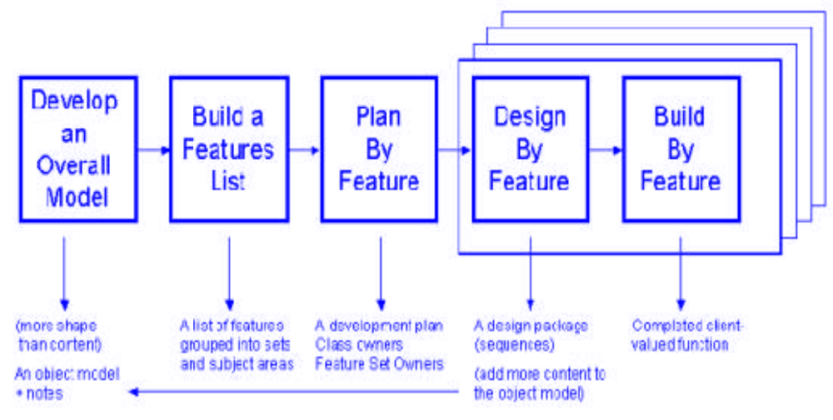
Feature Driven Development
Reprinted with permission of Peter Coad
These slides are designed to accompany Software Engineering: A Practitioner’s Approach, 7/e (McGraw-Hill, 2009) Slides copyright 2009 by Roger Pressman.

Slide 35
Agile Modeling
Originally proposed by Scott Ambler
Suggests a set of agile modeling principles
  Model with a purpose
  Use multiple models
  Travel light
  Content is more important than representation
  Know the models and the tools you use to create them
  Adapt locally
These slides are designed to accompany Software Engineering: A Practitioner’s Approach, 7/e (McGraw-Hill, 2009) Slides copyright 2009 by Roger Pressman.

